Slide 1

Aspect based Topic Modelling analysis on Yelp Restaurant Reviews
Project by: Neha Deshmukh (0640812)
Avneet Ahuja (0637330)

Slide 2
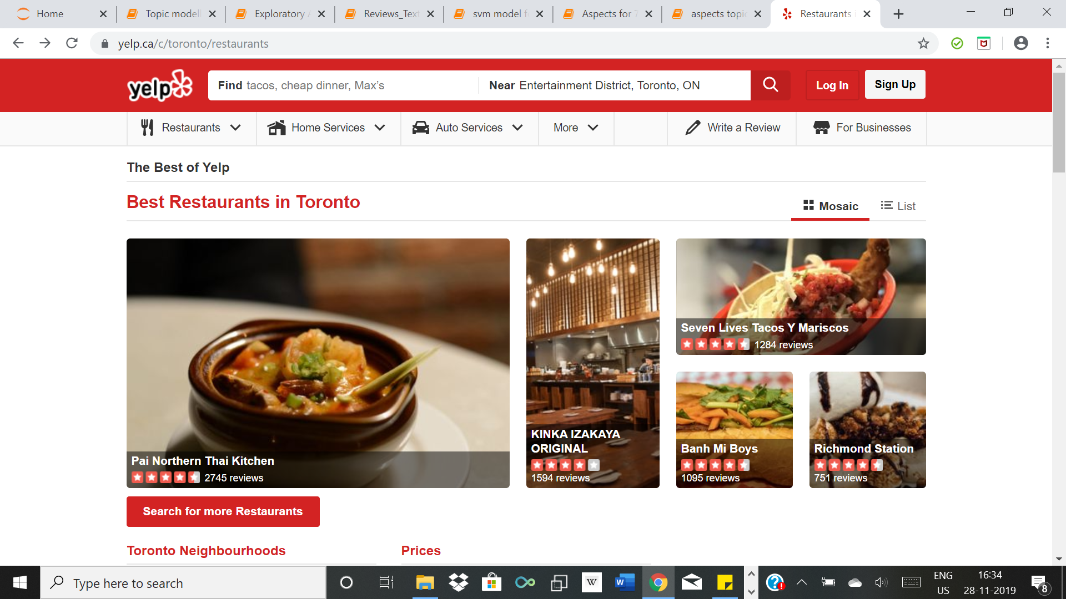
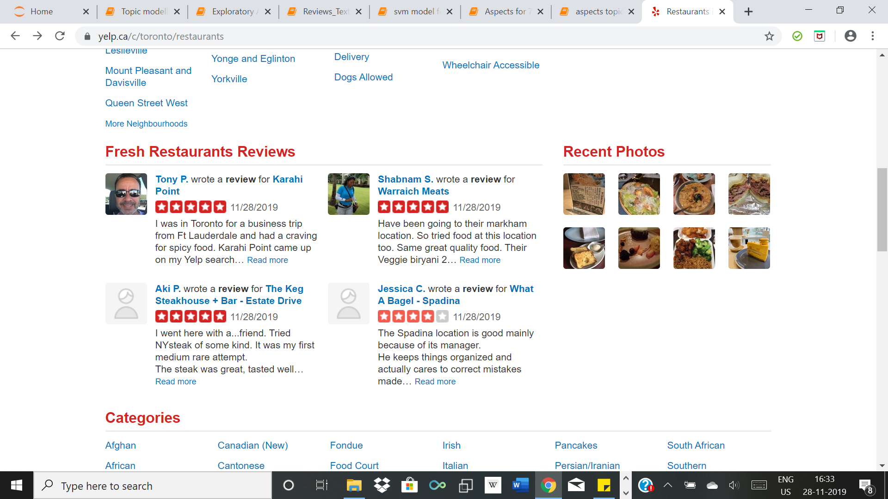
Introduction X Background

Slide 3
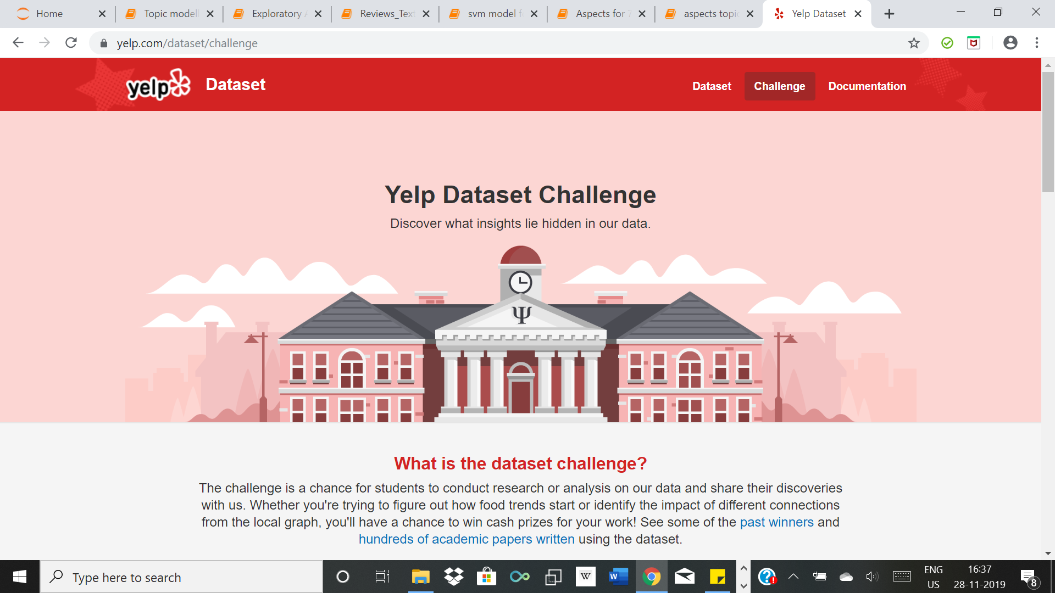
Introduction X Inspiration
Example Review:
“We were hoping for a quick breakfast. We were immediately seated, which was probably the highlight of our meal. It took about 15 min to get a coffee and another 15 min before anyone came to ask for our order. When our food finally came, nearly all of our food was undercooked; half cooked eggs, partially cooked ham and back bacon, overcooked bacon.”

Slide 4
Introduction X Research Questions
Identify sentiments of people for restaurants through performing topic modelling analysis on the reviews
Extract positive and negative sentiments of restaurant businesses by segregating them according to various aspects of the restaurants. (like ambience, quality of service etc.)
What did we use?
R (for cleaning)
Python (for rest of the project)
Tableau (basic exploratory visualisation)
Notes:
State that we converted all the files from json to csv

Slide 5
Step 1: Cleaning and Text pre-processing
Cleaning:
Removed data not related to restaurant reviews
Removed null rows
Kept columns that we relevant for our analysis
Text pre-processing
Change to lower case and remove punctuation (str.lower)
Tokenisation (nltk.word_tokenise)
Removal of stop words (stopwords from nltk library)
Stemming (PorterStemmer from nltk library)

Slide 6
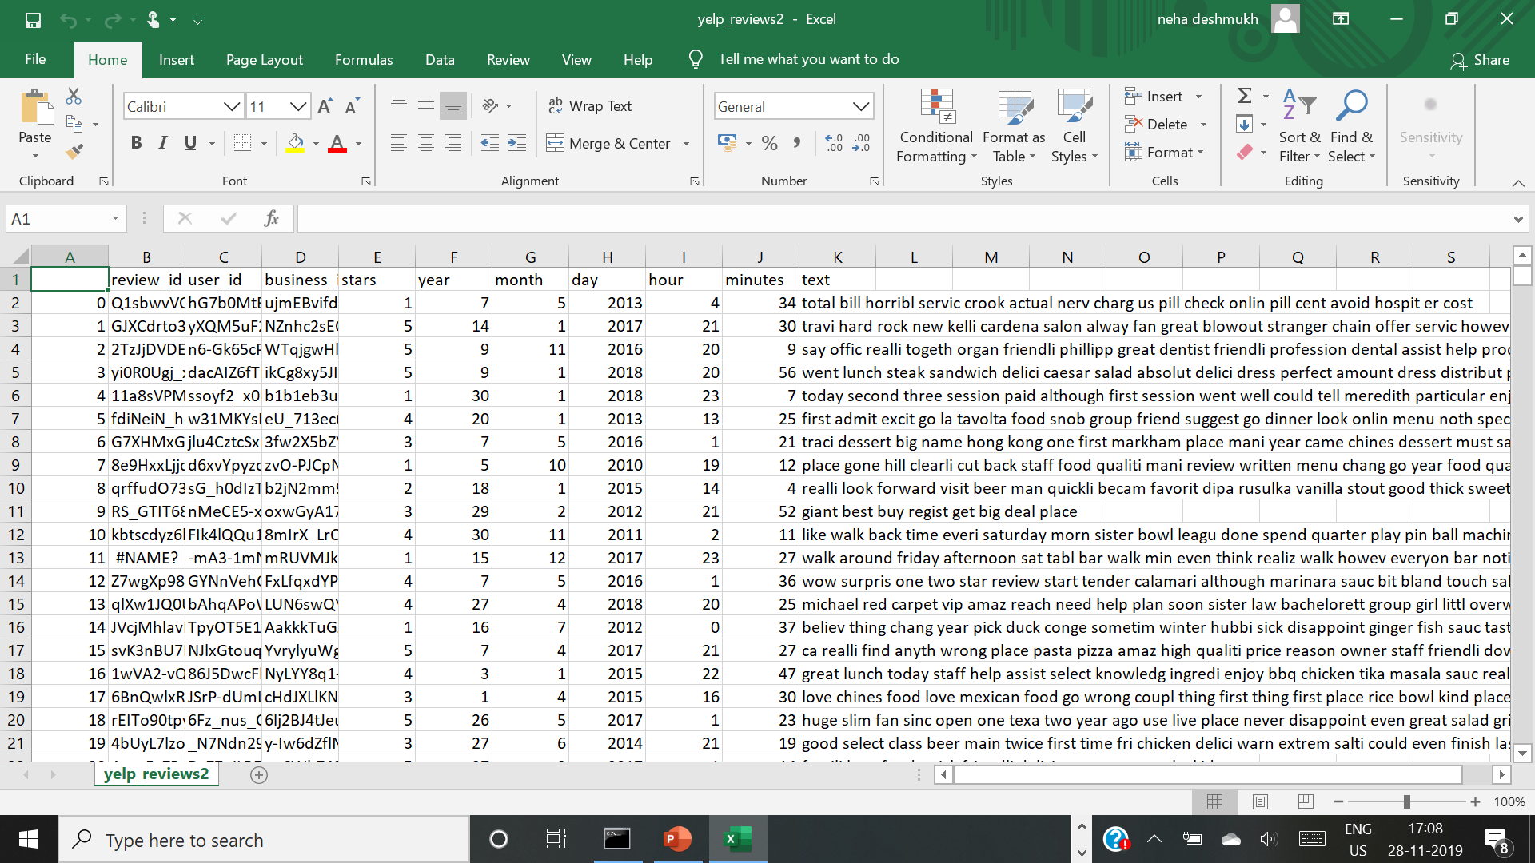
Step 1 X Result
Interesting Takeaway: To see the progress of the program, insert a progress bar using tqdm
library in Python. For a function, instead of apply, do progress_apply.
from tqdm._tqdm_notebook import tqdm_notebook
tqdm_notebook.pandas()

Slide 7
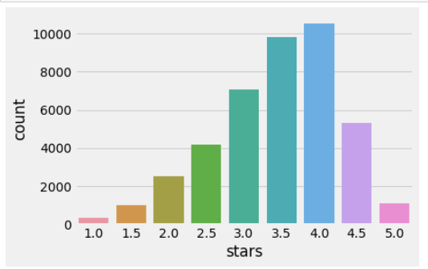
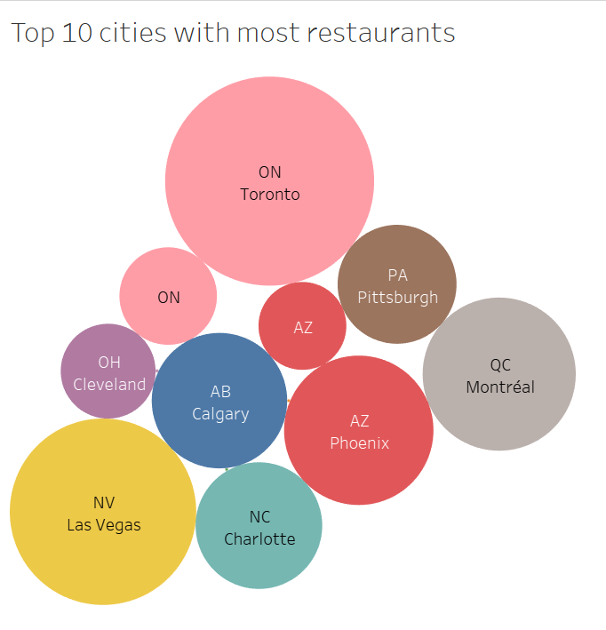
Step 2: Exploratory Analysis

Slide 8
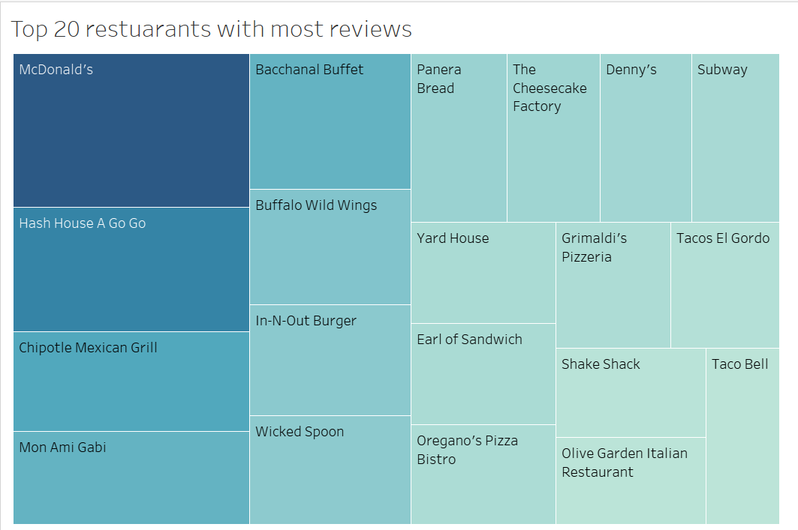
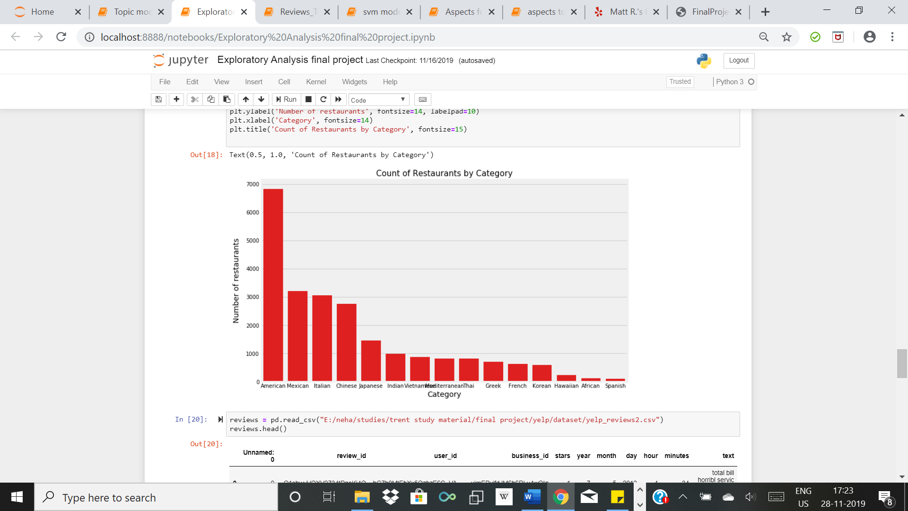
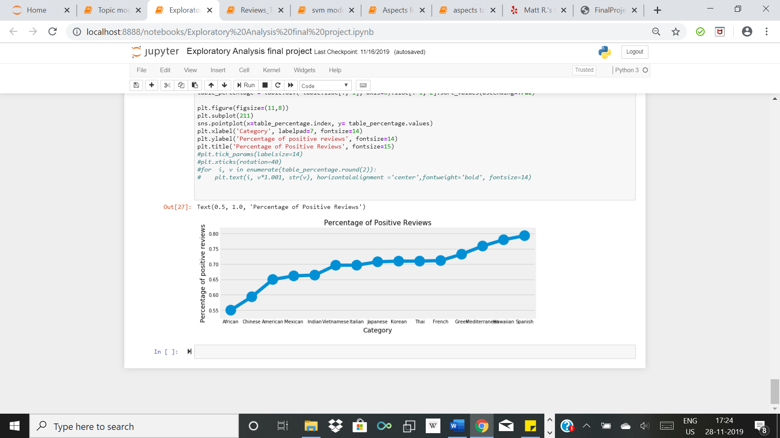
Step 2: Exploratory Analysis (continued)

Slide 9
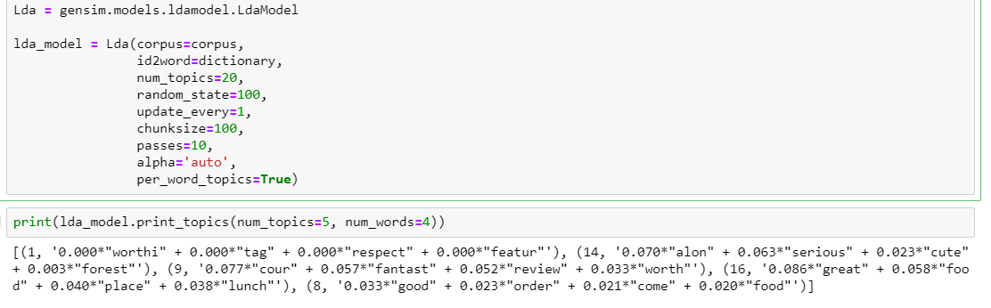
Step 3: Topic Modelling using LDA
Why use LDA?
Libraries used: Sklearn, Gensim and Mallet
LDA using Gensim:
LDA using Mallet:
ldamallet = gensim.models.wrappers.LdaMallet(mallet_path, corpus=corpus, num_topics=20, id2word=dictionary)
LDA using Sklearn:
from sklearn.decomposition import LatentDirichletAllocation
LDA = LatentDirichletAllocation(n_components=9, random_state=42)
LDA.fit(doc_term_matrix)

Slide 10
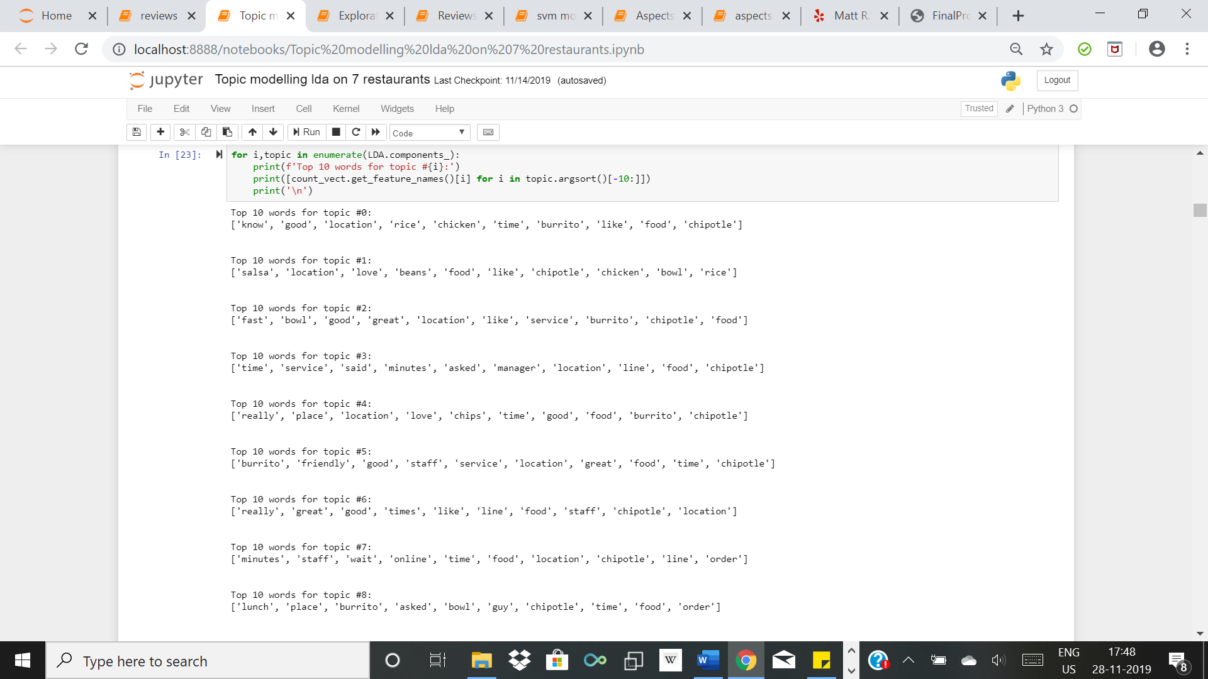
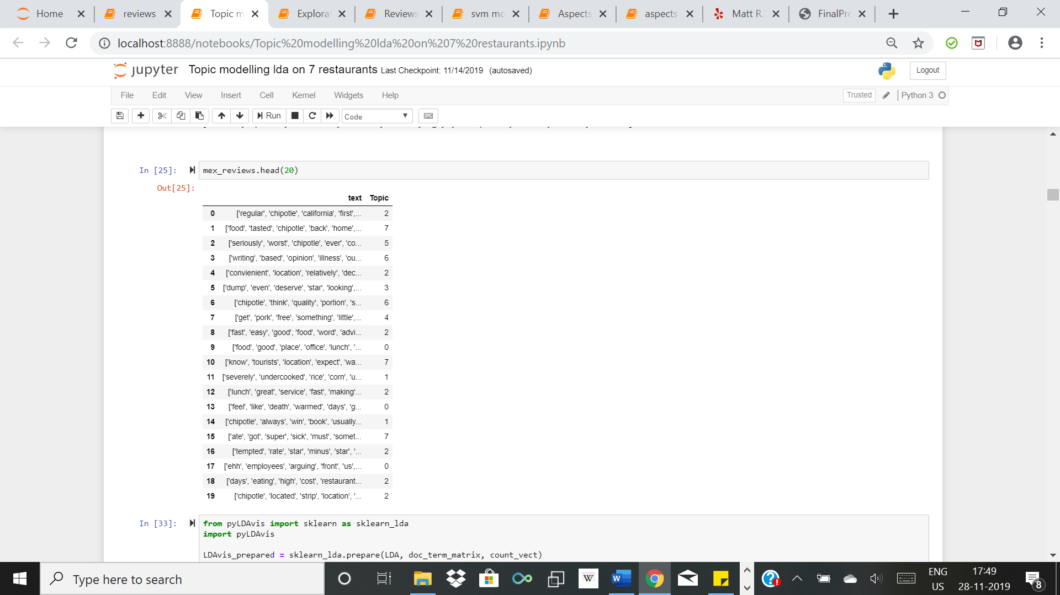
Step 3 X Visualisation of topics
Example restaurant: Chipotle Mexican Grill

Slide 11
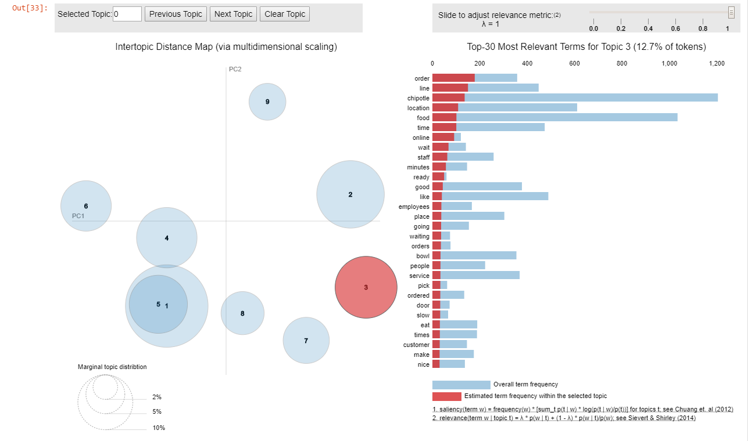
Visualisation of topics X continued

Slide 12
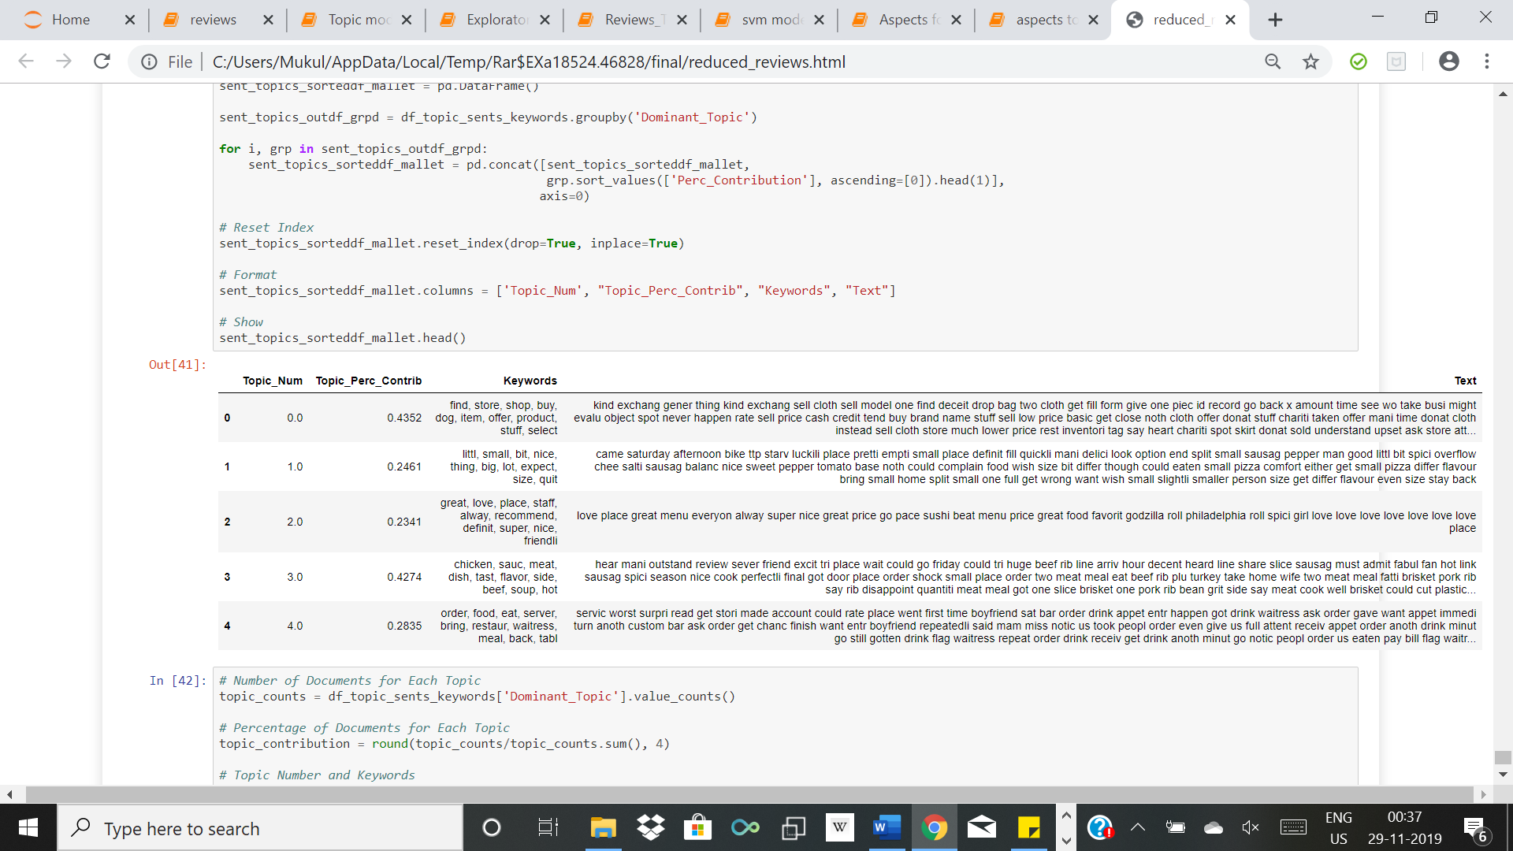
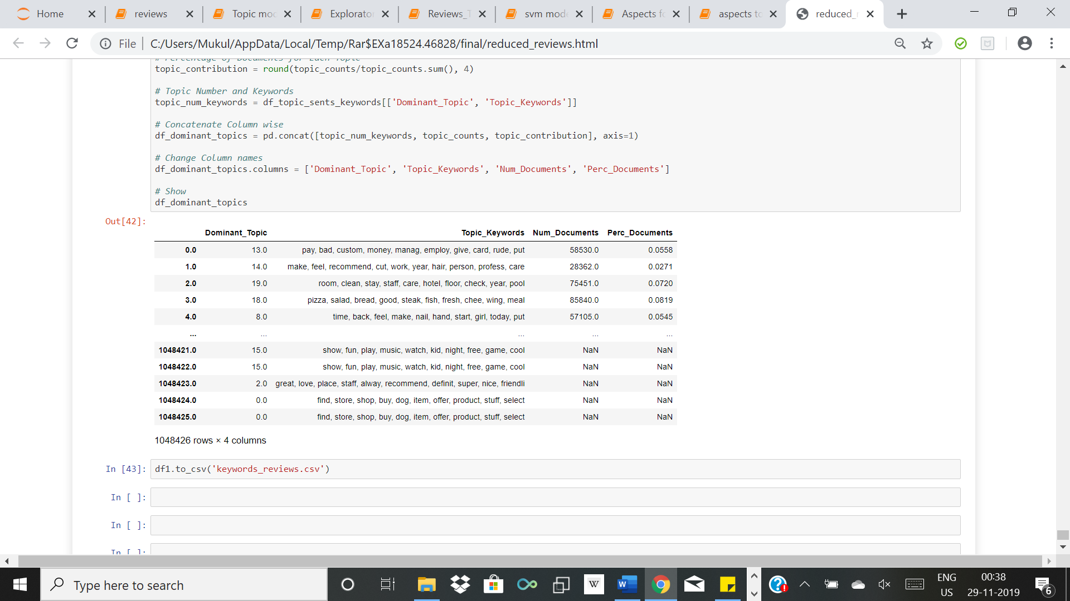
Topic Modelling on all the reviews

Slide 13
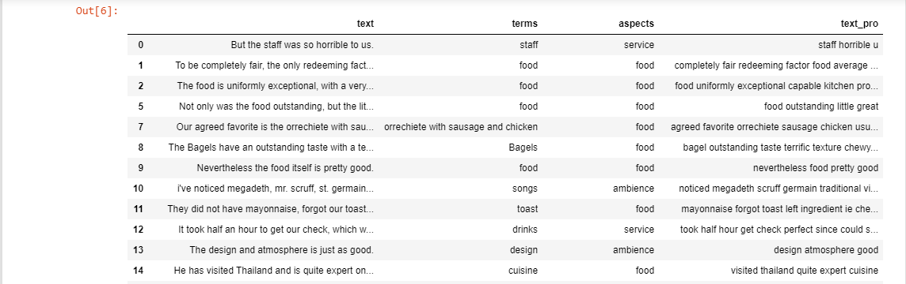
Step 4: Aspect oriented Topic Modelling X Dataset
Used annotated restaurant reviews dataset as training set to get the aspects.
Focused on Ambience, Service, Food and Price as different aspects in the restaurant reviews
Annotated dataset looks like this after cleaning and pre-processing,

Slide 14
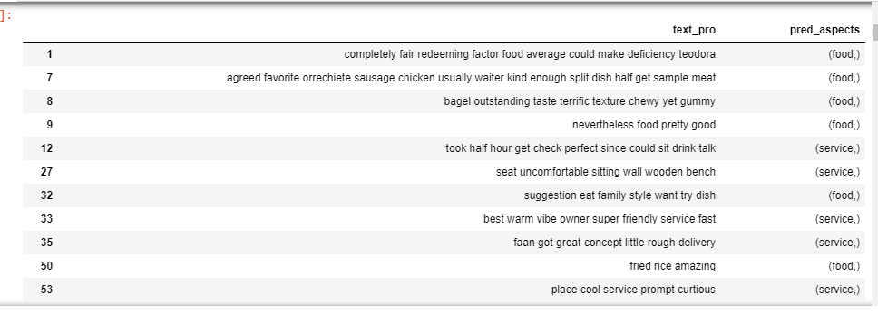
Step 4: Aspect oriented Topic Modelling X SVM Model
Tried with various models to check which model gives the highest accuracy; OneVsRest, MLKNN, Classifier Chains, Label Powerset and SVM
SVM gave the highest accuracy of 88.22%
Trying it on annotated dataset to check the result,

Slide 15
Step 4: Aspect oriented Topic Modelling X Using the model
Identification of opinion words by using available opinion lexicon for positive and negative words
Spacy’s dependency parser: Finds other dependent words on the opinion words found from the lexicon. This will give the aspect term
Assign sentiment score to the opinion word
Add the aspect terms with their scores to aspect categories; Food, Ambience, Service, Price
Used Glove pre-trained model on Wikipedia data and converted it to word2vec file format
Used word2vec’s n_similarity to find similarity between aspect categories and aspect terms
Also used the SVM model for this purpose

Slide 16
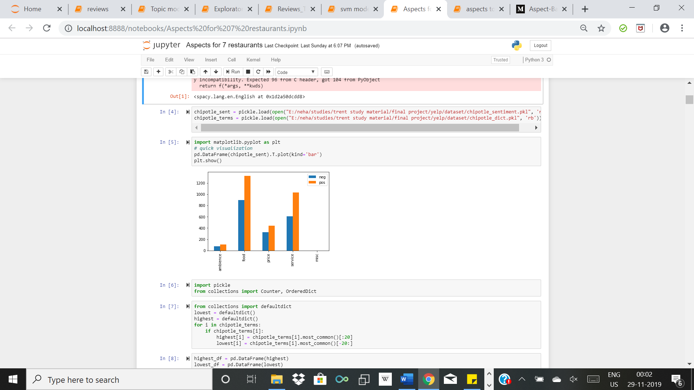
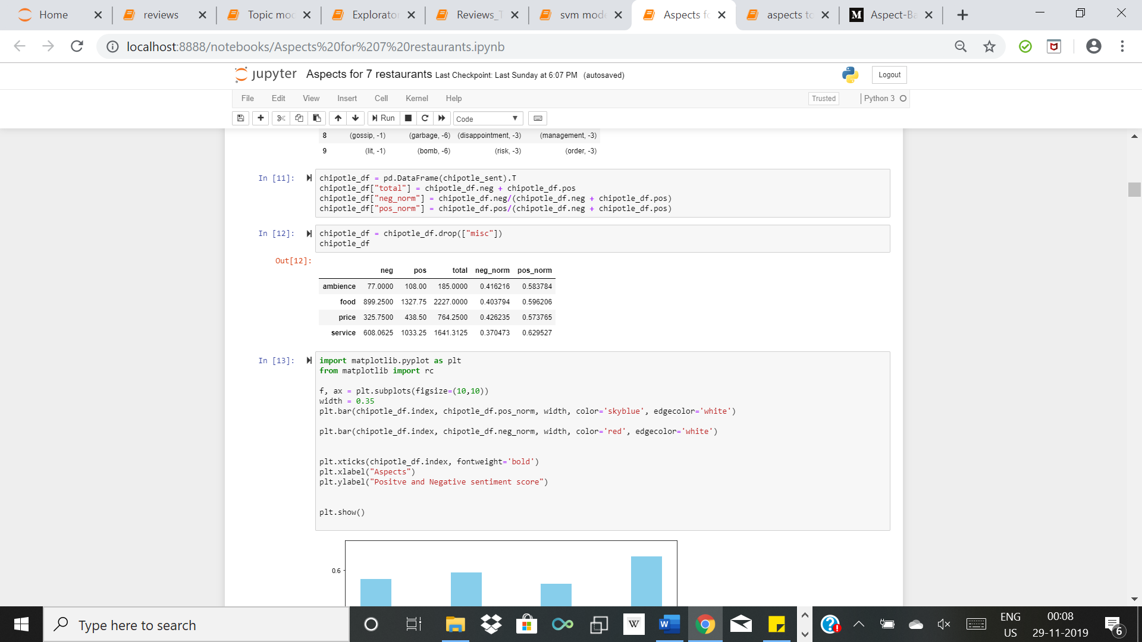
Step 4: Aspect oriented Topic Modelling X Visualising the result
Example restaurant: Chipotle Mexican Grill

Slide 17
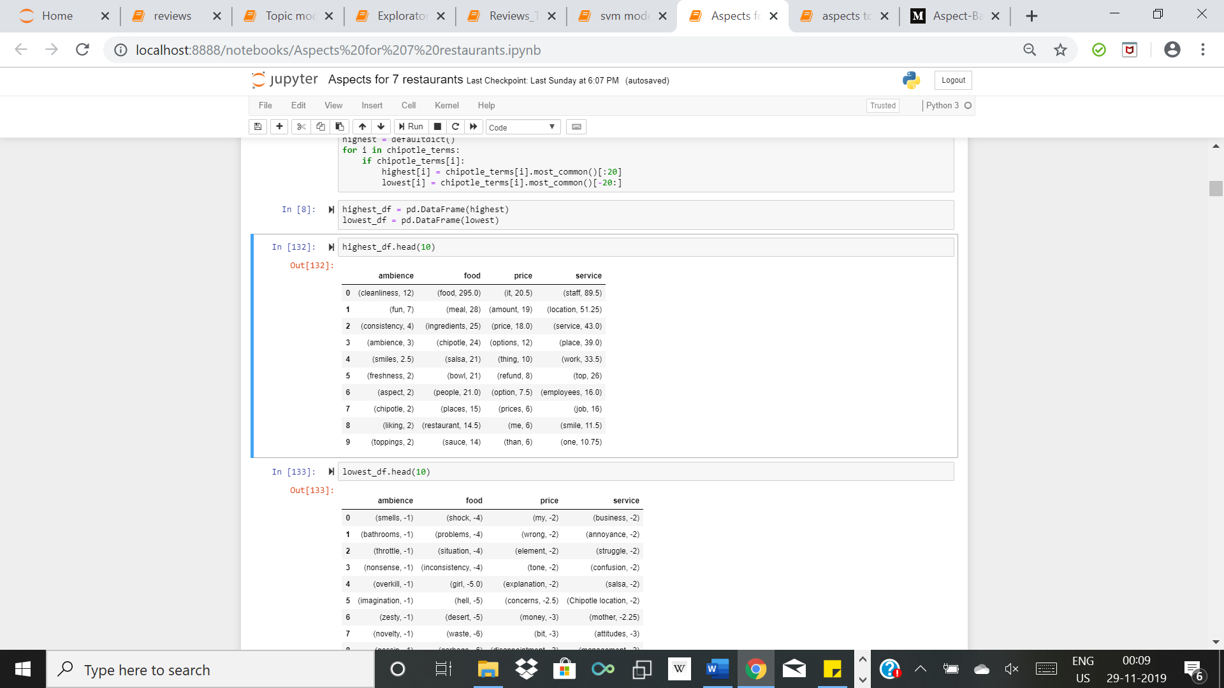
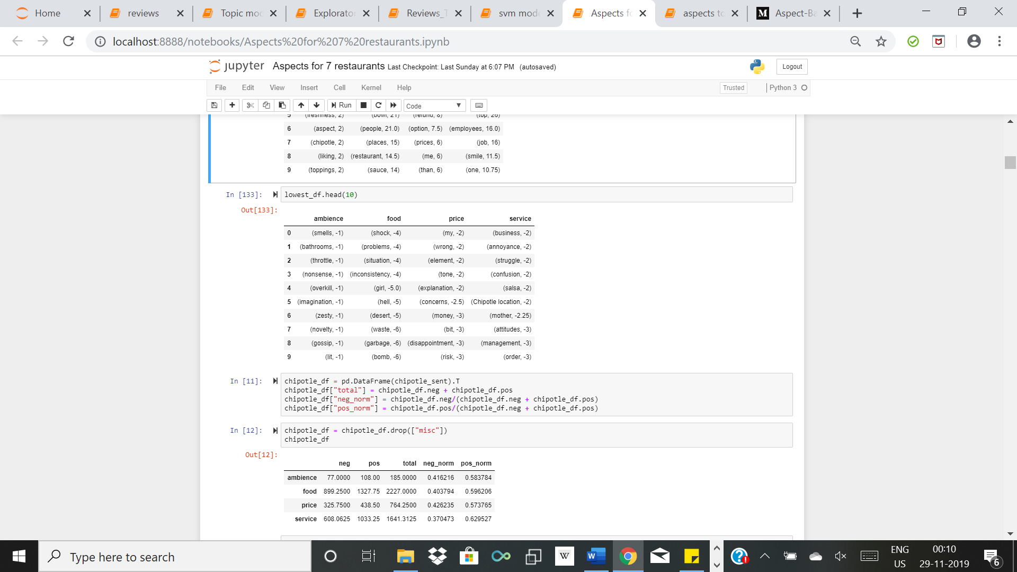
Step 4: Aspect oriented Topic Modelling X Visualising the result

Slide 18
Aspect oriented Topic Modelling X Conclusion
Performed Topic Modelling using LDA on reviews of the restaurants and found the topic words that people are using the most by visualising the results
Extracted positive and negative sentiments for various restaurant businesses and divided them according to aspects of the restaurants. This can better help the restaurant business to identify the areas in which they can improve

Slide 19
Aspect oriented Topic Modelling X Future Scope
Depending on the sentiments about the different aspects of the restaurant, it can be possible to predict the star ratings for that business
It is possible to use this analysis to build a restaurant recommender system for users by taking into account the user reviews for other restaurants
Instead of using LDA, there is another topic modelling algorithm that can be used; LDA2VEC. Not much work done here and therefore, it is a good research option

Slide 20
Thank You!

